Slide 1
epidemic to pandemic

Slide 2
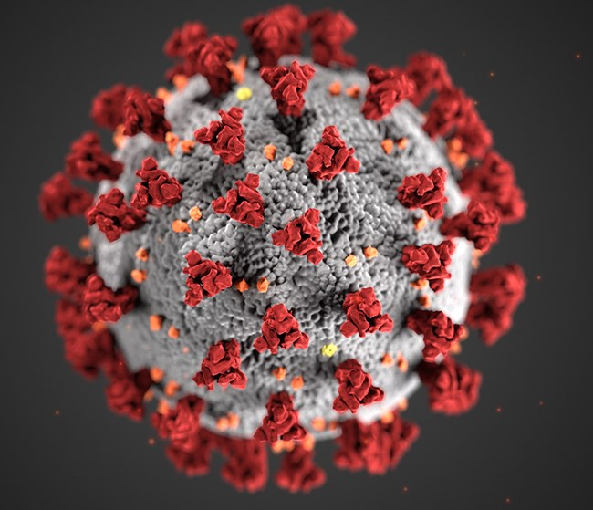
PROJECT MADE BY SHIVAM KUMAR

Slide 3
in December 2019, COVID-19 coronavirus was first identified in the Wuhan region of China. By March 11, 2020, the World Health Organization (WHO) categorized the COVID-19 outbreak as a pandemic. A lot has happened in the months in between with major outbreaks in Iran, South Korea, and Italy AND INDIA.
We know that COVID-19 spreads through respiratory droplets, such as through coughing, sneezing, or speaking. But, how quickly did the virus spread across the globe. And, can we see any effect from country-wide policies, like shutdowns and quarantines.
Fortunately, organizations around the world have been collecting data so that governments can monitor and learn from this pandemic. Notably data repository to consolidate this data from sources like the WHO, the Centers for Disease Control and the Ministry of Health from multiple countries.
In this notebook, we will visualize COVID-19 data from the first several weeks of the outbreak to see at what point this virus became a global pandemic in india to our some states.
I WOULD LIKE TO REPRESENT SOME CONDITION IN INDIA
THESE ARE RELATED TO SOME STATES

Slide 4
import pandas as pd
import numpy as np
import matplotlib.pyplot as plt
df=pd.read_csv("C:\\Users\\LENOVO\\Downloads\\covid_19_india.csv")
df
Sno | Date | Time | State/UnionTerritory | ConfirmedIndianNational | ConfirmedForeignNational | Cured | Deaths | Confirmed
0 | 1 | 2020-01-30 | 6:00 PM | Kerala | 1 | 0 | 0 | 0 | 1
1 | 2 | 2020-01-31 | 6:00 PM | Kerala | 1 | 0 | 0 | 0 | 1
2 | 3 | 2020-02-01 | 6:00 PM | Kerala | 2 | 0 | 0 | 0 | 2
3 | 4 | 2020-02-02 | 6:00 PM | Kerala | 3 | 0 | 0 | 0 | 3
4 | 5 | 2020-02-03 | 6:00 PM | Kerala | 3 | 0 | 0 | 0 | 3
... | ... | ... | ... | ... | ... | ... | ... | ... | ...
18105 | 18106 | 2021-08-11 | 8:00 AM | Telangana | - | - | 638410 | 3831 | 650353
18106 | 18107 | 2021-08-11 | 8:00 AM | Tripura | - | - | 77811 | 773 | 80660
18107 | 18108 | 2021-08-11 | 8:00 AM | Uttarakhand | - | - | 334650 | 7368 | 342462
18108 | 18109 | 2021-08-11 | 8:00 AM | Uttar Pradesh | - | - | 1685492 | 22775 | 1708812
18109 | 18110 | 2021-08-11 | 8:00 AM | West Bengal | - | - | 1506532 | 18252 | 1534999
18110 rows × 9 columns

Slide 5
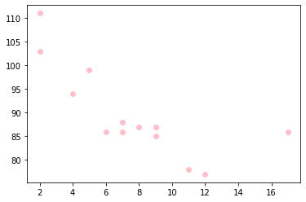
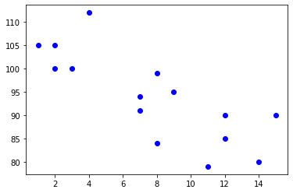
#simple scatter plot:
import matplotlib.pyplot as plt
import numpy as np
x = np.array([5,7,8,7,2,17,2,9,4,11,12,9,6])
x = np.array([4,6,9,3,6,17,6,2,4,11,13,8,5])
plt.scatter(x, y, color ='pink')
x = np.array([2,2,8,1,15,8,12,9,7,3,11,4,7,14,12
y =np.array([100,105,84,105,90,99,90,95,94,100,79,112,91,80,85])
plt.scatter(x, y, color = 'blue')

Slide 6
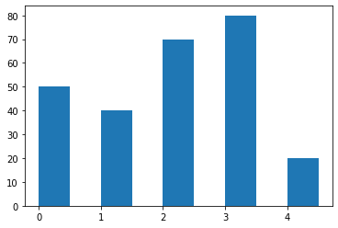
plt.show()
#matplotlib bars
from matplotlib import pyplot as plt
plt.bar([0.25,1.25,2.25,3.25,4.25],[50,40,70,80,20],label="kerala",width=.5)

Slide 7
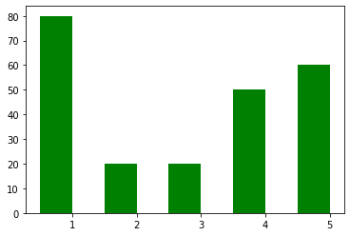
plt.bar([.75,1.75,2.75,3.75,4.75],[80,20,20,50,60],label="Telangana", color='green',width=.5)

Slide 8
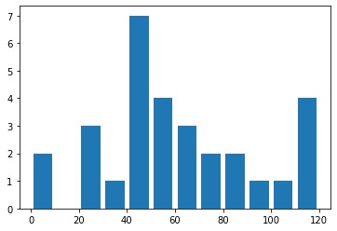
#matplotlib – Histogram
import matplotlib.pyplot as plt
population_age = [22,55,62,45,21,22,34,42,42,4,2,102,95,85,55,110,120,70,65,55,111,115,80,75,65,54,44,43,42,48]
bins = [0,10,20,30,40,50,60,70,80,90,100,110,120]
plt.hist(population_age, bins, histtype='bar', rwidth=0.8)

Slide 9
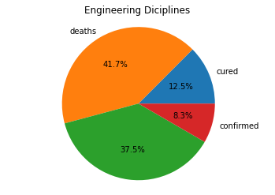
import numpy as np
import matplotlib.pyplot as plt
# if using a Jupyter notebook, include:
%matplotlib inline
# Pie chart, where the slices will be ordered and plotted counter-clockwise:
labels = ['cured', 'deaths', '', 'confirmed']
sizes = [15, 50, 45, 10]
fig, ax = plt.subplots()
ax.pie(sizes, labels=labels, autopct='%1.1f%%')
ax.axis('equal') # Equal aspect ratio ensures the pie chart is circular.
ax.set_title('Engineering Diciplines')
plt.show()

Slide 10
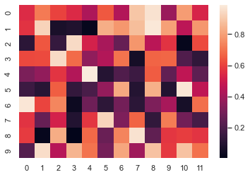
import numpy as np; np.random.seed(0)
import seaborn as sns; sns.set_theme()
uniform_data = np.random.rand(10, 12)
ax = sns.heatmap(uniform_data
)

Slide 11
THANK YOU

